Slide 1
S.R.S SR.SEC.SCHOOL ROHTAK
Name:-Yugansh sapra
Class:-12th sci
Roll no. :- 1209
Topic:- SAY NO TO TOBACCO.

Slide 2
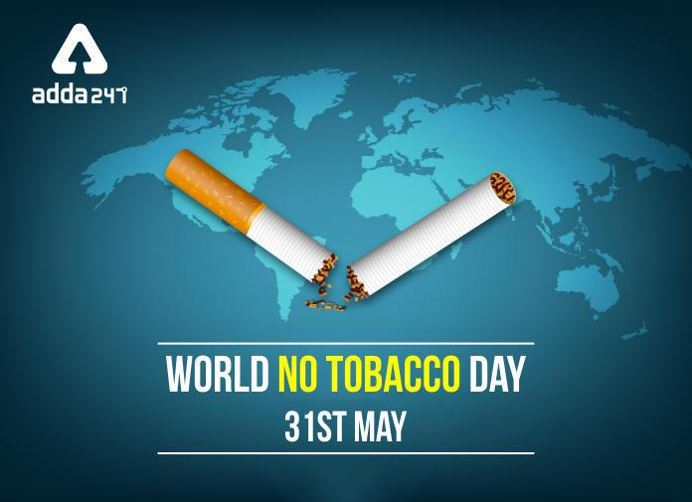
Introduction:-
Welcome to our presentation on World Tobacco Day, an annual observance held on May 31st. World Tobacco Day serves as a global platform to raise awareness about the health risks associated with tobacco use and to advocate for effective policies to reduce tobacco consumption. This day provides an opportunity for individuals, organizations, and governments around the world to come together and take action against the tobacco epidemic. Each year, World Tobacco Day focuses on a specific theme that highlights a particular aspect of tobacco control.

Slide 3
Overview of TOBACCO:-
Tobacco is a plant native to the Americas, belonging to the Solanaceae family. It has been used for centuries for various purposes, most notably for smoking and chewing. Tobacco contains nicotine, an addictive substance that affects the central nervous system. The use of tobacco has been a subject of controversy due to its negative health effects and societal implications
Tobacco has a rich history dating back thousands of years. It was first cultivated and used by indigenous peoples in the Americas for medicinal and ceremonial purposes. Following European colonization, tobacco spread worldwide and became a major cash crop. Its popularity grew rapidly, leading to the developmeTobacco is a plant native to the Amer

Slide 4
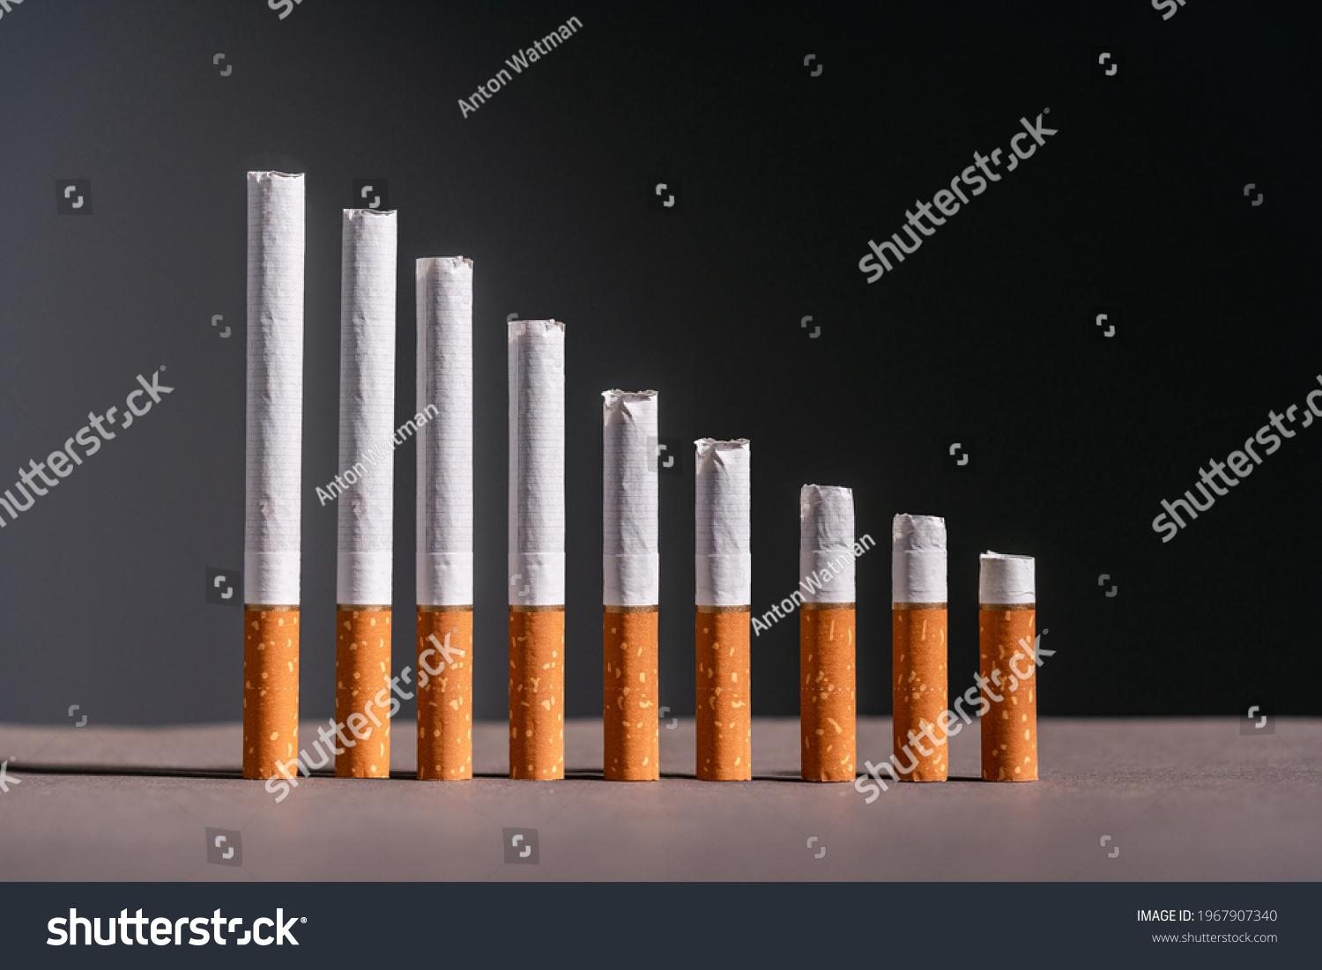
Health effect of TOBACCO
. Smoking causes cancer, heart disease, stroke, lung diseases, diabetes, and chronic obstructive pulmonary disease (COPD), which includes emphysema and chronic bronchitis. Smoking also increases risk for tuberculosis, certain eye diseases, and problems of the immune system, including rheumatoid arthritis. Secondhand smoke exposure contributes to approximately 41,000 deaths among nonsmoking adults and 400 deaths in infants each year. Secondhand smoke causes stroke, lung cancer, and coronary heart disease in adults. Children who are exposed to secondhand smoke are at increased risk for sudden infant death syndrome, acute respiratory infections, middle ear disease, more severe asthma, respiratory symptoms, and slowed lung growth.

Slide 5
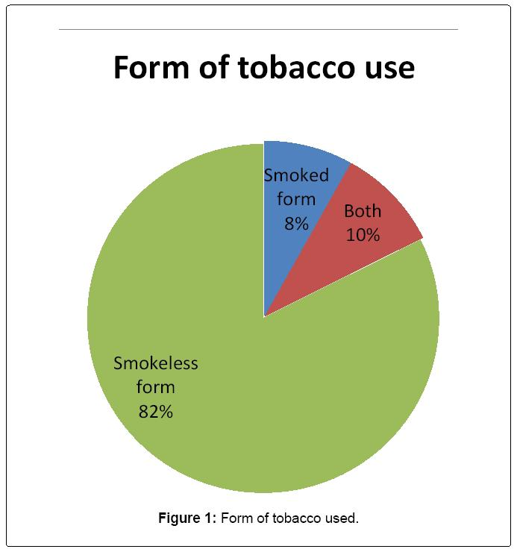
Tobacco usage in India:-
Nearly 267 million adults (15 years and above) in India (29% of all adults) are users of tobacco, according to the Global Adult Tobacco Survey India, 2016-17. The most prevalent form of tobacco use in India is smokeless tobacco and commonly used products are khaini, gutkha, betel quid with tobacco and zarda. Smoking forms of tobacco used are bidi, cigarette and hookah
Globally, tobacco use is one of the biggest public health threats. It leads not only to loss of lives but also has heavy social and economic costs. The total economic costs attributed to tobacco use from all diseases in India in the year 2017-18 for persons aged 35 years and above amounted to INR 177 341 crore (USD 27.5 billion).

Slide 6
Tobacco usage & measures:-
Prevention can take the form of policy-level measures, such as increased taxation of tobacco products; stricter laws (and enforcement of laws) regulating who can purchase tobacco products; how and where they can be purchased; where and when they can be used (i.e., smoke-free policies in restaurants, bars, and other public places); and restrictions on advertising and mandatory health warnings on packages. Over 100 studies have shown that higher taxes on cigarettes, for example, produce significant reductions in smoking, especially among youth and lower-income individuals.217 Smoke-free workplace laws and restrictions on advertising have also shown benefits.218 Prevention can also take place at the school or community level. Merely educating potential smokers about the health risks has not proven effective.218 Successful evidence-based interventions aim to reduce or delay initiation of smoking, alcohol use, and illicit drug use, and otherwise improve outcomes for children and teens by reducing or mitigating modifiable risk factors and bolstering protective factors. Risk factors for smoking include having family members or peers who smoke, being in a lower socioeconomic status, living in a neighborhood with high density of tobacco outlets, not participating in team sports, being exposed to smoking in movies, and being sensation-seeking.

Slide 8
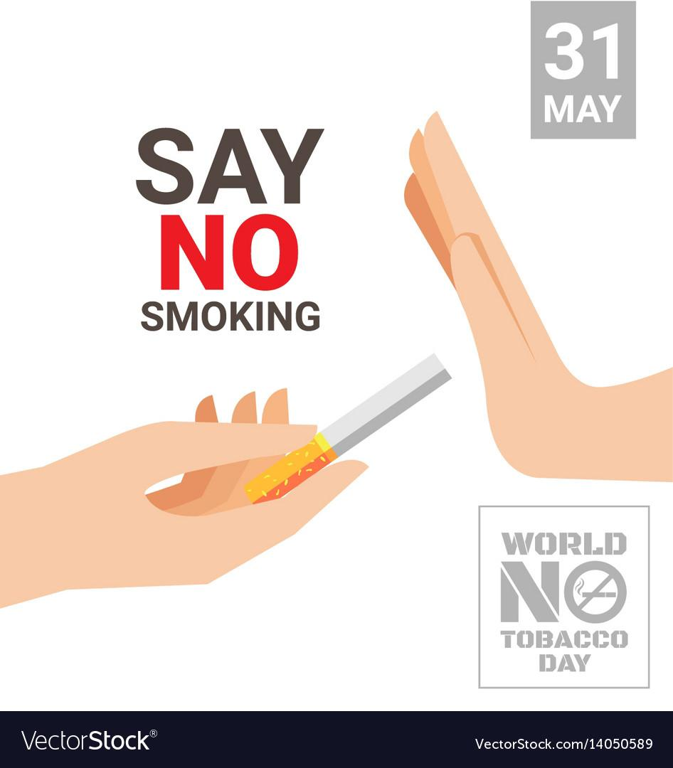
SAY NO TO TOBACCO 🙅‍♂️
Thanking you
YUGANSH SAPRA

